Slide 1
Chapter Thirteen
Congress

Slide 2
Congress
The intent of the Framers:
  To oppose the concentration of power in a single institution
  To balance large and small states
    Bicameralism
    House of Representatives and Senate
  To avoid the tyranny of the majority, or populism
They expected Congress to be the dominant institution

Slide 3
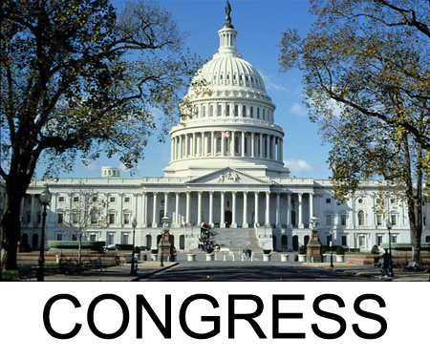
Interpreting the Constitution of the United States
Article I

Slide 4
Section 1:
This section provides for a BICAMERAL legislature, consisting of a
HOUSE OF REPRESENTATIVES and SENATE.

Slide 5
What are the terms of office of the House of Representatives?
2 years
What are the terms of Senators?
6 years

Slide 6
Section 2:
Hilary, age 32, wants to run for office in the House of Representatives. Does the Constitution permit her to do so?
YES THE MINIMUM AGE IS 25

Slide 7
In 1790, the state of Rhode Island had approximately 60,000 people. How many Representatives would Rhode Island have in the House according to the formula prescribed by the Constitution?
2 REPRESENTATIVES

Slide 8
We see that taxation based on population was removed by Amendment XVI. Rather than direct taxes being based on population, this amendment allows the national government to tax INCOME.

Slide 9
How is the system of checks and balances represented in the “sole power” granted to the House of Representatives?
SOLE POWER OF IMPEACHMENT OF EXECUTIVE AND JUDICIAL—CAN REMOVE FOR CAUSE
IMPEACHMENT IS A TRIAL: PROSECUTOR, JUDGE, AND JURY

Slide 10
Section 3:
How can we see that representation in the Senate is equal among the states?
2 SENATORS PER STATE; ONE VOTE EACH

Slide 11
Why does the Constitution break the Senate into three classes?
ROTATING ELECTIONS TO PREVENT REVOLUTIONARY CHANGE

Slide 12
Jeff, a 37 year old tax attorney from New York, wishes to run for the Senate. He currently lives in Tampa, Florida. Is he allowed to run for Senator for New York? Why or why not?
NO, MUST BE AN INHABITANT OF STATE

Slide 13
The Senate is voting for President Obama’s funding request for the bank bailout. There is an even split among the 100 senators. Who casts the final vote?
THE VICE PRESIDENT AS PRESIDENT OF THE SENATE

Slide 14
As a further “check,” what “sole power” is the Senate granted? Why do you think this is the case?
SIT AS JURY ON IMPEACHMENT CASES; 2/3 NECESSARY TO REMOVE—CAN ONLY PUNISH BY REMOVAL FROM OFFICE, BUT IMPEACHED OFFICER MAY STILL BE LIABLE FOR CRIMES OR CIVIL ACTIONS.
NO DECISIONS OF PEOPLE WITHOUT CONSENT OF STATES

Slide 15
Section 5:
Why does the Constitution require that each house publish a journal of its proceedings that is to include the voting record of each of its members?
TO INFORM PUBLIC, HOLD REPRESENTATIVES ACCOUNTABLE TO PEOPLE

Slide 16
Section 6:
Do members of Congress receive a salary? If so, who pays?
YES, THE US TREASURY -- $6 A DAY, NOW $174,000 A YEAR WITH $400,000 ALLOWANCES
ORIGINALLY $6 A DAY

Slide 17
Section 7:
All tax bills must originate in the HOUSE Why do you think that this is the case?
REPRESENTATIVE OF THE PEOPLE

Slide 18
The House of Representatives proposes a bill that would provide all Americans with health insurance. The Senate approves the bill and passes it to the President. The President disagrees with the bill and vetoes it. What must occur in order for the health insurance bill to become a law?
OVERRIDE WITH 2/3DS OF BOTH HOUSES

Slide 19
Section 8:
What are three powers granted to Congress that helped to stabilize the nation’s economy?
TAX
BORROW MONEY
REGULATE COMMERCE
COIN MONEY
GIVE PATENTS

Slide 20
What are three powers granted to Congress that provided for the “common defense” of the nation?
DEFINE AND PUNISH CRIMES ON HIGH SEAS
DECLARE WAR
MAINTAIN NAVY AND ARMY
CALL UP MILITIA

Slide 21
What clause allows Congress to go beyond its enumerated powers?
NECESSARY AND PROPER CLAUSE

Slide 22
Section 9:
How is Section 9 different from Section 8?
RESTRICTIONS ON LEGISLATURE

Slide 23
What are four powers denied to Congress?
RESTRICT SLAVE TRADE TIL 1808
SUSPEND HABEAS CORPUS UNLESS PUBLIC SAFETY
NO ATTAINDER (GROUP GUILTY WITHOUT TRIAL)
NO EX POST FACTO LAW
NO INTERSTATE TARIFFS
NO PREFERENTIAL TREATMENT TO ANY STATE
NO TITLES OF NOBILITY

Slide 24
Section 10:
It can be said that federalism is most noticeable in Article I, Section 10. Explain.
EXPLICIT LIMITATIONS OF THE POWERS OF THE STATES

Slide 25
The states of California and New York have decided to protest U.S. involvement in Afghanistan. They create the “Alliance for Afghan Liberation,” refusing to acknowledge the power of the national government so long as President Obama insists on keeping troops in Iraq. Do California and New York have the right to create such an alliance? Explain.
NO, CANNOT ENTER INTO AGREEMENT WITH ANOTHER STATE OR FOREIGN POWER

